Slide 1
TDD In Action

Slide 2
Career Benefits of TDD
Become top 10% developer
Progress quicker
Reduce Stress
Notes:
Become a Top 10% Developer:
Practicing TDD demonstrates a disciplined approach to coding, aligning with best practices followed by elite developers.
It sets you apart as someone who values quality and reliability.
More Pragmatic Developer:
TDD encourages writing only the necessary code, avoiding over-complication and waste.
It fosters a "just enough" mindset while ensuring the software meets its requirements.
Reduces Stress:
Automated tests reduce the burden of manual testing, especially for repetitive tasks.
As you build tests alongside your code, you can release changes confidently, knowing that regressions are unlikely.

Slide 3
Benefits of TDD
Confidence
Better Code Design
Go faster in the long run
Minimize YAGNI
Reduce maintenance costs

Slide 4
Confidence
Automated tests that cover application behavior
Allows you to refactor without fear
Refactoring legacy, change and pray
Notes:
Automated tests act as a safety net, validating that application behavior remains intact.
Refactoring becomes less daunting, enabling smoother improvements and updates without fear of breaking things.

Slide 5
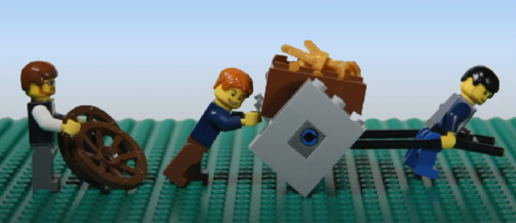
Go faster in the long run
We often hear, we have no time to write tests
Do you have time to do it twice?
Changes become progressively cheaper
Majority of developer time is maintenance
Notes:
While tests may initially seem time-consuming, they save time by preventing rework.
“Do we have time to do it twice?” is a strong argument against skipping tests.
Over time, changes become cheaper as tests cover a larger surface of your application, reducing the effort required for validation.

Slide 6
Better code design
Starting from tests, means code has to be testable
Notes:
Writing tests first enforces good design principles since code must be testable.
This naturally results in cleaner, more modular, and maintainable code.

Slide 7
Minimize YAGNI
Each failing tests has a clear goal
Avoids over-engineering
Notes:
Failing tests ensure that you write code only to meet specific goals.
It prevents over-engineering by focusing on what is immediately required.

Slide 8
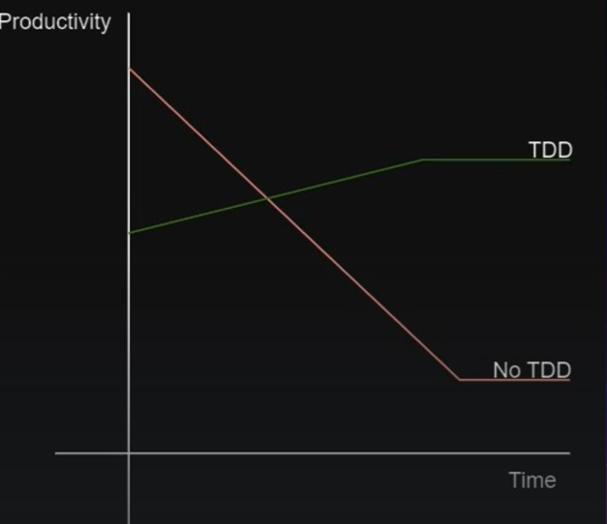
Reduce maintenance costs
Reduce bugs
Reduce manually testing of functionality
Automatically retest the application in seconds
Notes:
Automated tests catch bugs early, leading to fewer defects in production.
They also significantly reduce the manual testing effort, as application functionality can be revalidated in seconds.

Slide 9

What is TDD?
Notes:
Historical Context:
TDD was introduced by Kent Beck in the late 1990s as part of Extreme Programming (XP) practices.
Its so long that TDD exists but very few developers still use it. Despite it being in existence for over 25 years.
It revolutionized the development process by prioritizing automated testing.

Slide 10
TDD Rules
You should only write production code to pass a failing unit test.
You should write no more of a unit test than is necessary to pass a failing unit test.
You should not write more of the test than to make it fail for the right reason.
Triangulation: Only implement real logic once pattern repeats three times
Notes:
Write Production Code to Pass a Failing Unit Test:
Never write code without a reason; a failing test gives you that reason.
Write Just Enough Test to Fail:
Keep your tests focused and minimal, ensuring they fail for the right reason.
Write No More Production Code Than Necessary to Pass:
Avoid over-engineering. Write just enough to meet the test criteria.
Triangulation:
Implement real logic only after observing the same pattern at least three times.
This helps ensure your solution is generic and not just a one-off fix.

Slide 11
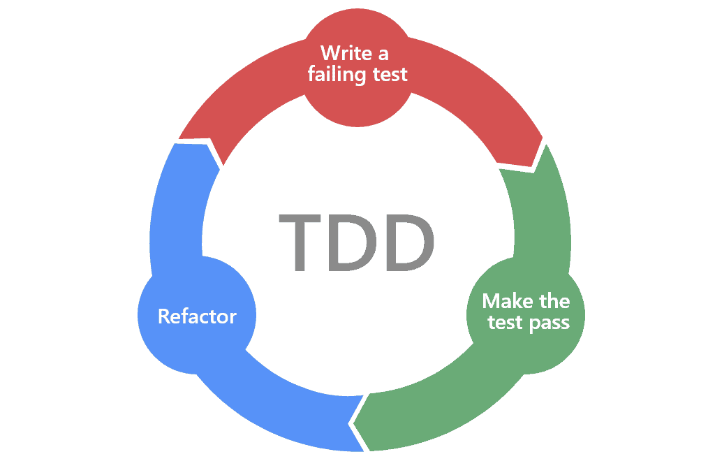
Red.. Green.. Refactor..

Slide 12
First Exercise FizzBuzz
Write a function that takes positive integers and outputs their string representation.
Your function should comply with the following additional rules:
If the number is a multiple of three, return the string "Fizz".
If the number is a multiple of five, return the string "Buzz".
If the number is a multiple of both three and five, return the string "FizzBuzz". For example, given the numbers from 1 to 15 in order, the function would return:
"1", "2", "Fizz", "4", "Buzz", "Fizz", "7", "8", "Fizz", "Buzz", "11", "Fizz", "13", "14", "FizzBuzz"

Slide 13
Exercises:
#1 – Leap Year
Write a function that returns true or false depending on whether its input integer is a leap year or not. A leap year is defined as one that is divisible by 4 but is not otherwise divisible by 100 unless it is also divisible by 400. For example, 2001 is a typical common year and 1996 is a typical leap year, whereas 1900 is an atypical common year and 2000 is an atypical leap year.
#2 – Fibonacci
Write some code to generate the Fibonacci number for the nth position ex:
First Fibonacci numbers in the sequence are: 0, 1, 1, 2, 3, 5, 8, 13, 21, 34

Slide 14
More Rules
2-minute rule
Test code is 1st class citizen - Naming
Arrange/Act/Assert
Test "What" not "How"
Notes:
If test code is treated well then it becomes dumping ground at nobody wants to touch it after a while.
People tend to do pretty bad things in there
Focus on testing behavior rather than implementation details.

Slide 15
2-minute rule
Keeps you focused
Maintains momentum
Encourages simplicity
Notes:
The 2-minute rule in Test-Driven Development (TDD) emphasizes a quick cycle of writing, running, and validating tests. It ensures you’re moving incrementally and maintaining focus. Here's how it works:
Write a Test: Start by writing a simple, failing test for the next small piece of functionality. This should take no more than 2 minutes.
Make It Pass: Implement just enough code to make the test pass. Again, aim to do this within 2 minutes.
Refactor: Once the test passes, clean up the code to improve its design while ensuring the tests still pass.
Why the 2-Minute Rule?
Keeps you focused: It prevents you from overthinking or overengineering solutions.
Maintains momentum: Short cycles keep the pace brisk and engaging.
Encourages simplicity: You write the minimal amount of code required to solve a problem.
This rule isn’t a strict timer but rather a guideline to ensure you break problems into bite-sized, manageable chunks.

Slide 16
Test "What" not "How"
Ensures tests remain resilient to refactoring.
Keeps tests aligned with functional requirements.
Focus on testing behavior rather than implementation details.

